Slide 1
MULTICAST ROUTING

Slide 2
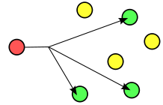
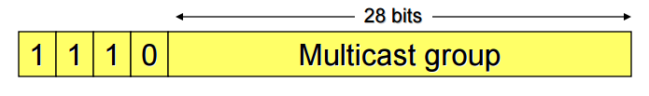
What is Multicast Routing?
Group communication where source transmits data to a group of destination hosts simultaneously
Data is duplicated in ovs switches and forwarded to current members of group
Class D addresses in the range of 224.0.0.0 to 239.255.255.255 (summarized as 224.0.0.0/4) are reserved for IPv4 multicast routing

Slide 3
Benefits
Reduces network traffic by sending a single copy of data
Conserves bandwidth in the network
Hosts can be configured for multicasting without hardware upgrades
Applications
Video/Audio streaming
Internet Television

Slide 4
IGMP
Host-to-switch protocol
Used to establish multicast group memberships
IGMPv3 supports ‘source filtering’
Versions: IGMPv1, IGMPv2, IGMPv3
Types of IGMPv3 messages:
Membership Query
Membership Report

Slide 5
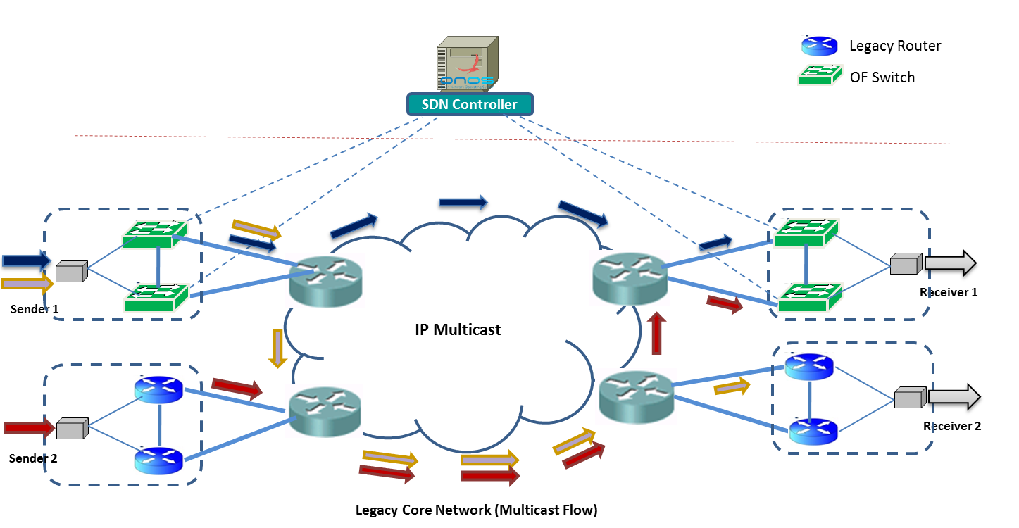
Multicast Service Model

Slide 6
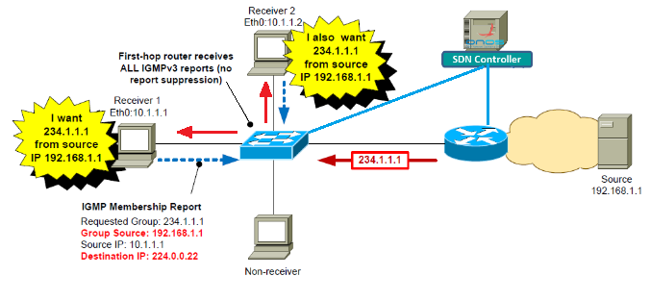
Joining a group

Slide 7
Problem Statement
Implementing and Analyzing Multicast Functionality in POX Controller
Module to handle IGMP PacketIn messages
Dijkstra’s – shortest paths from server to all nodes
Flow Installation only for clients using Dijkstra’s shortest path map
Flushing existing flows, recalculating Dijkstra’s graph & installing flows for new client requests during multicast streaming

Slide 8
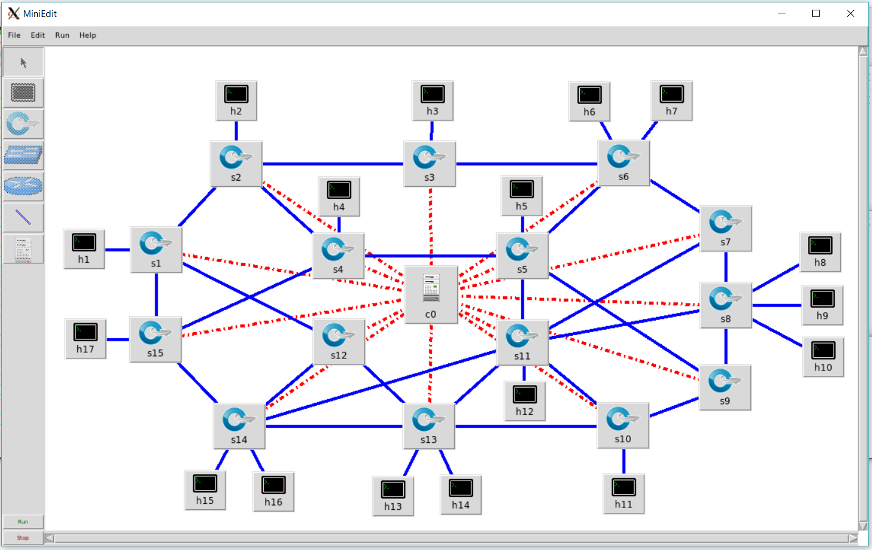
Network in MiniEdit
Server

Slide 9
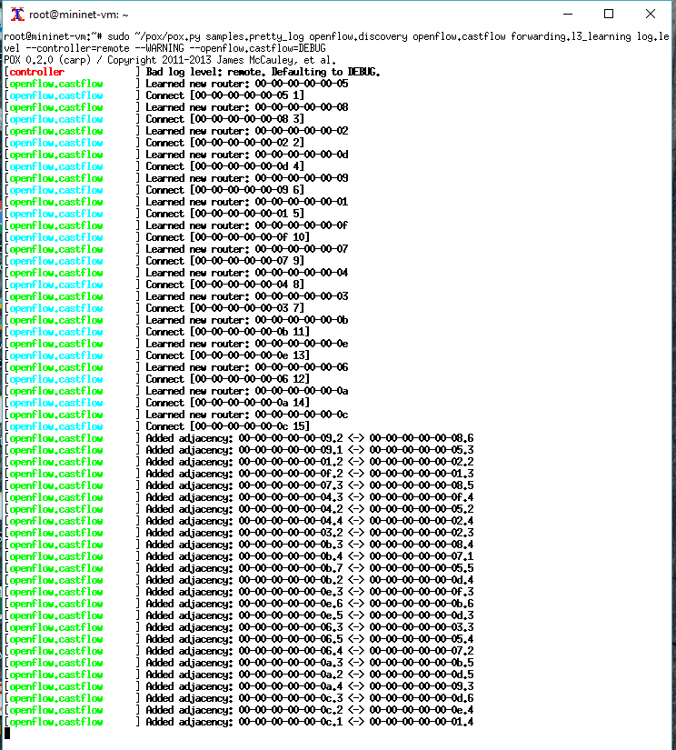
Network Connectivity in POX
Links in Network

Slide 10
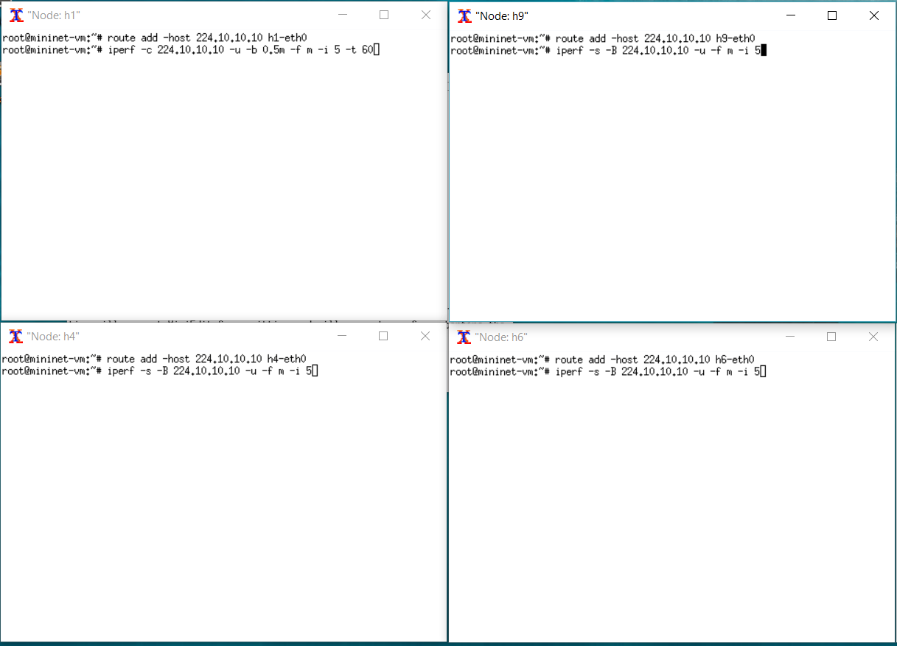
Setting up Server and Clients
Server:
iperf -c <Multi_grp_ip> -u -b 0.5m -f m -i 5 -t 30
Server
Client
Clients:
iperf -s -B <Multi_grp_ip> -u -f m -i 5
Client
Client
Reference: IBM’s Website
‘Route add’ command tell the host that multicast routing should go through the "eth0" interface

Slide 11
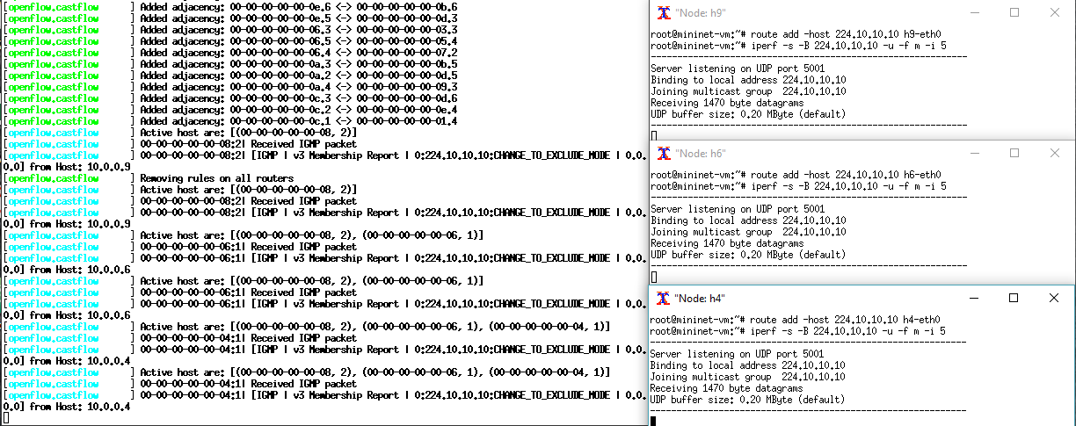
IGMP Request for Multicast Reception
Clients

Slide 12
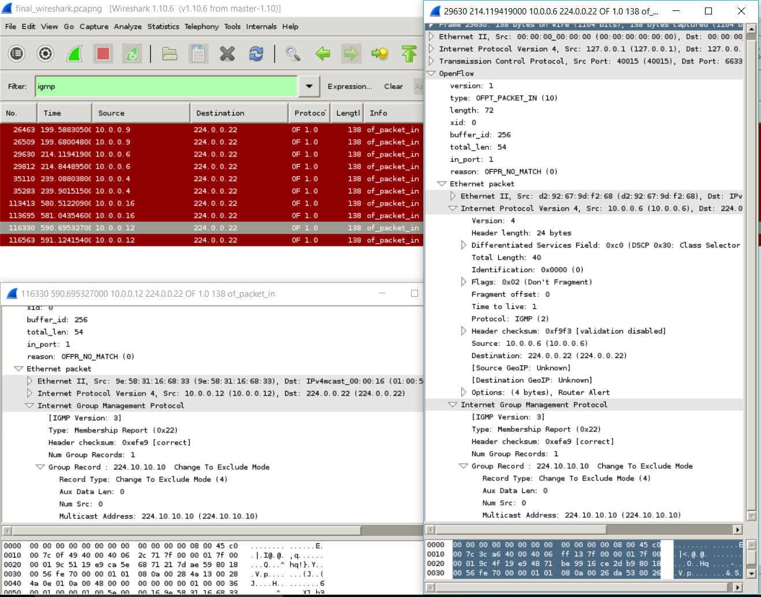
Request to join multicast group
Notes:
Change to exclude: Filter mode changed to Exclude
Change to Include: Filter mode changed to Include

Slide 13
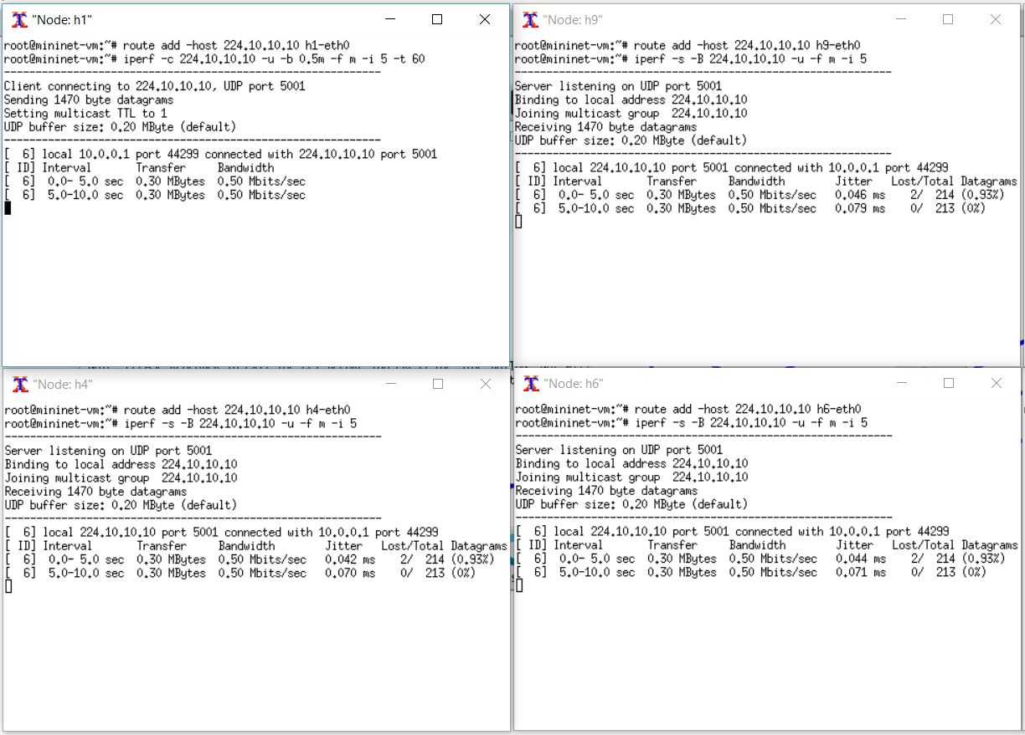
Multicast Streaming to Clients

Slide 14
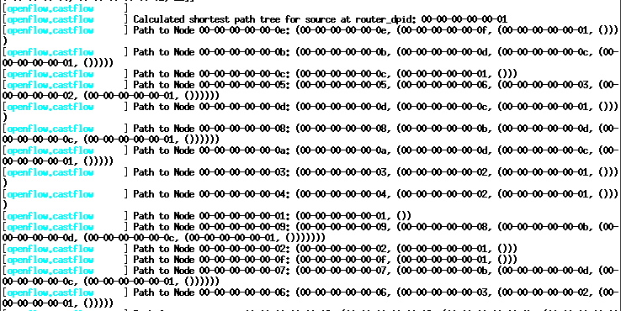
Dijkstra’s Shortest Paths from Server to All Nodes

Slide 15
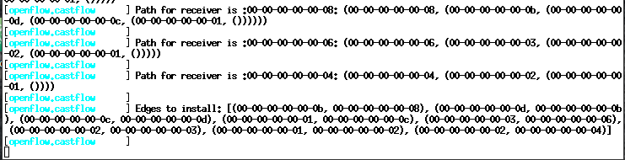
Installed Paths from Server to Clients

Slide 16
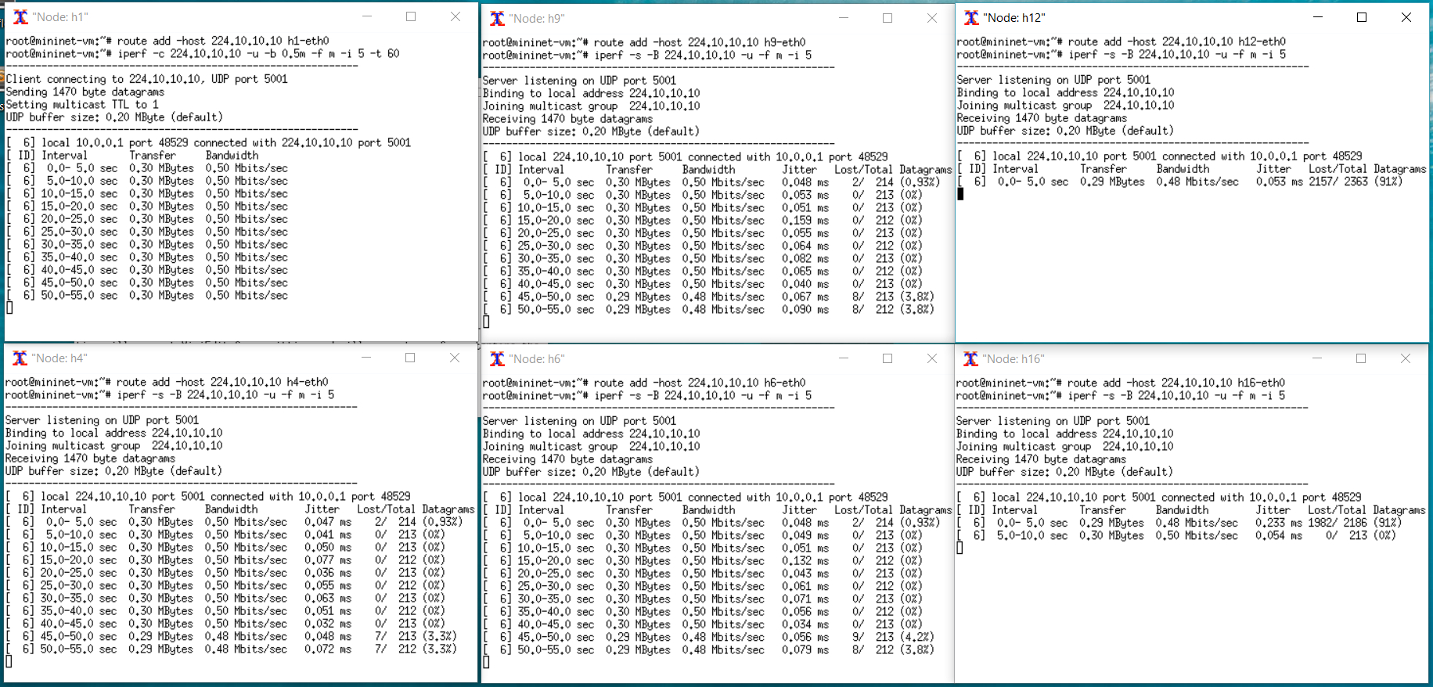
New Clients joining existing Multicast Stream

Slide 17
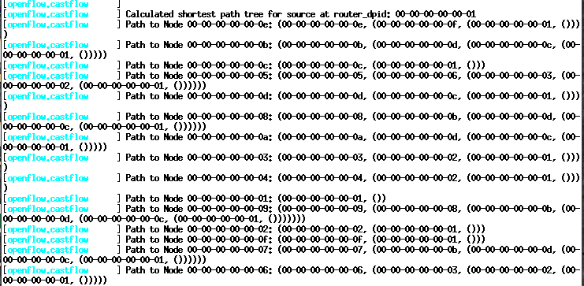
Dijkstra’s Shortest Paths from Server to All Nodes

Slide 18
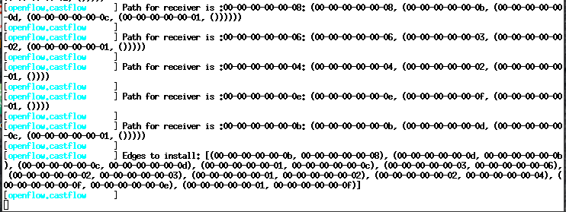
Installed Paths from Server to All Clients

Slide 19
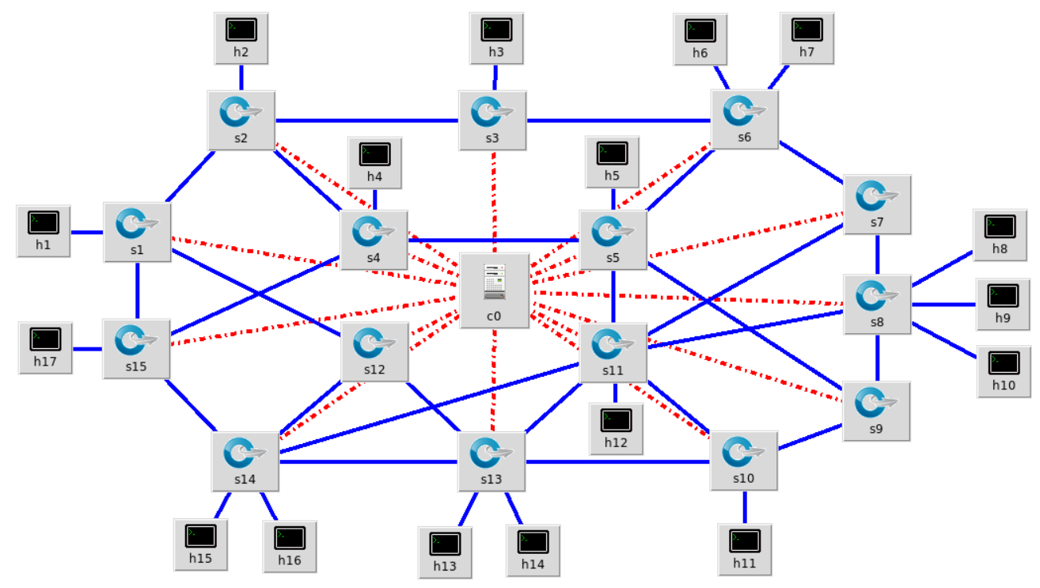
Installed Paths from Server to All Clients

Slide 20
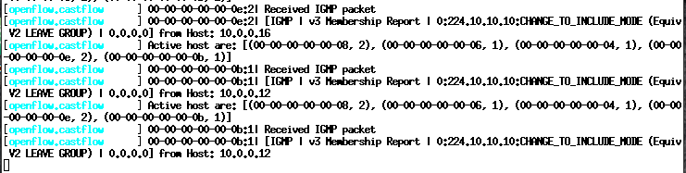
IGMP PacketIn to the controller to leave the Multicast Group

Slide 21
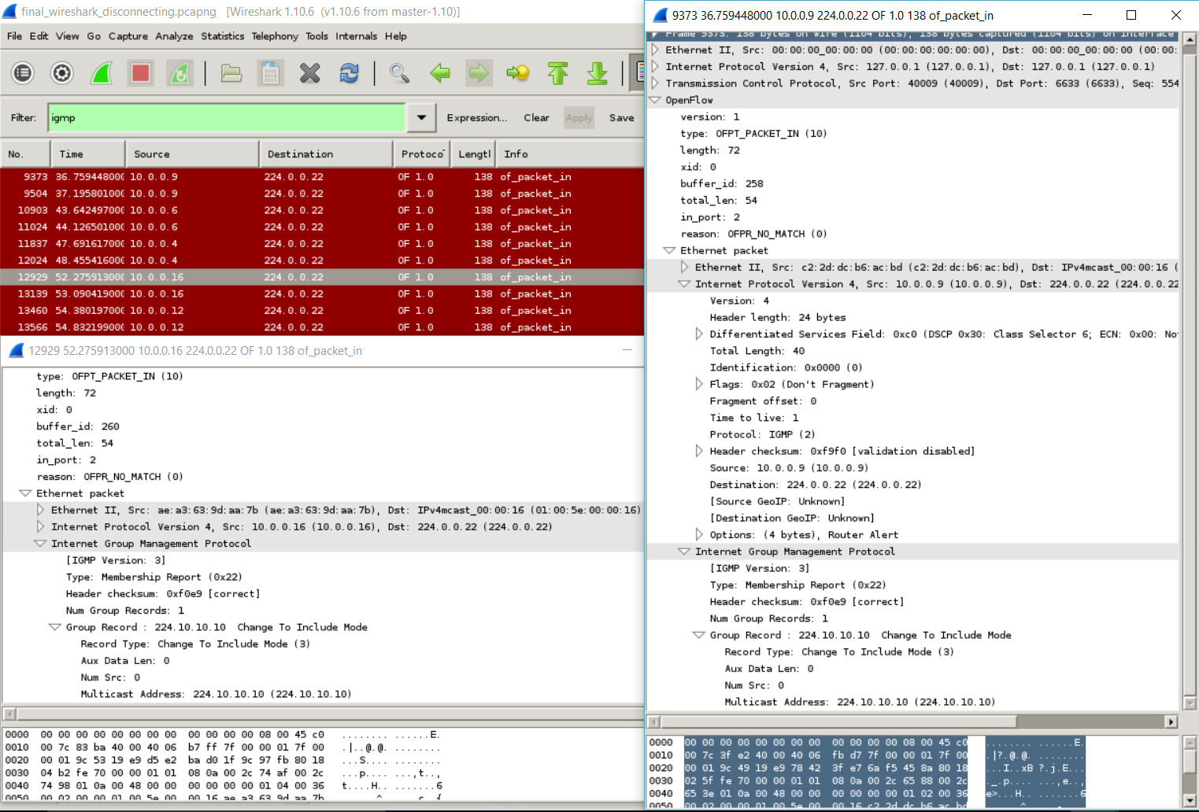
Request to leave multicast group
Source IP and IP for IGMPv3
Multicast Address

Slide 22
Conditions considered
Start clients first and then run server
Start server first and then start clients to join the group
While streaming, another non-client wants to join the stream (add a new client using client commands)
While streaming to multiple clients, end the clients one by one using ‘Ctrl+C’ in client terminals. When all clients leave, even if the server serves, since we do not have any active hosts, the switch will not PacketIn (thereby saving processing packets)

Slide 23
Steps to run demonstration
Prerequisite:
Place file ‘multicast.py’ in /home/mininet/pox/pox/openflow/
Place file ‘igmpv3.py’ in /home/mininet/pox/pox/lib/packet/
Steps:
Run the MiniEdit network
Run the POX controller using command :
sudo ~/pox/pox.py samples.pretty_log openflow.discovery openflow.multicast forwarding.l3_learning log.level --WARNING –openflow.multicast=DEBUG
3. Run the clients first and then the server
On Clients : route add –host <Multicast_address> <server_host>-Ethernet
(First) iperf –s –B <Multicast_address> -u –f m –i 5
e.g. route add –host 224.10.10.10 h9-eth0
iperf –s –B 224.10.10.10 –u –f m –i 5

Slide 24
On Server : route add –host <Multicast_address> <server_host>-Ethernet
(Next) iperf –c <Multicast_address> -u –b 0.5m –f m –i 5 –t 60
e.g. route add –host 224.10.10.10 h1-eth0
iperf –c 224.10.10.10 –u –b 0.5m –f m –i 5 –t 60
4. In POX and Wireshark, look for the following:
i. Reception of IGMP packets
ii. Dijkstra’s shortest path map
iii. Installed paths from server to active clients
5. If new hosts want to join the multicast group in the existing network, run the command
On Clients : route add –host <Multicast_address> <server_host>-Ethernet
iperf –s –B <Multicast_address> -u –f m –i 5
6. In POX and Wireshark, look for the updated installed paths from serve to all clients

Slide 25
Questions and Answers
Why did we use Dijkstra’s shortest path algorithm instead of Kruskal’s algorithm?
Our aim is to find shortest paths from server node to its client nodes only, thereby neglecting all the other (non-client) nodes in the network.
Dijkstra’s algorithm fits best for our use, as it finds the shortest path tree between server node and all nodes. A shortest path tree is a tree that connects server node to all nodes in the graph and has the property that the length of any path from server node to any other node in the graph is minimized. From this shortest path tree, it is easy to extract the paths for the client nodes only.
On the other hand, Kruskal’s algorithm covers all the nodes in the graph. It selects a minimum length edge of all possible edges which connect two different disjoint MST components, found so far. So it results into a least cost path covering all the nodes in the network. This does not necessarily mean that it will yield a least cost path from server to client. This can be proved by a number of examples. It gives an overall minimum path in the network.
One of the important reasons for us to choose Dijkstra’s algorithm over Kruskal’s algorithm is that Dijkstra’s path tree map is in sequential order. So we just need to identify the clients and pick up the already obtained paths for them. In case of Kruskal’s algorithm, it gives a non-sequential list of edges. To find a path from server to client, we need to first identify clients and trace a reverse path from client to server using the tuples in the list, which is tedious. Hence, we preferred Dijkstra’s algorithm to Kruskal’s algorithm.

Slide 26

Note : The video is in the folder sent to you.

Slide 27


